Slide 1
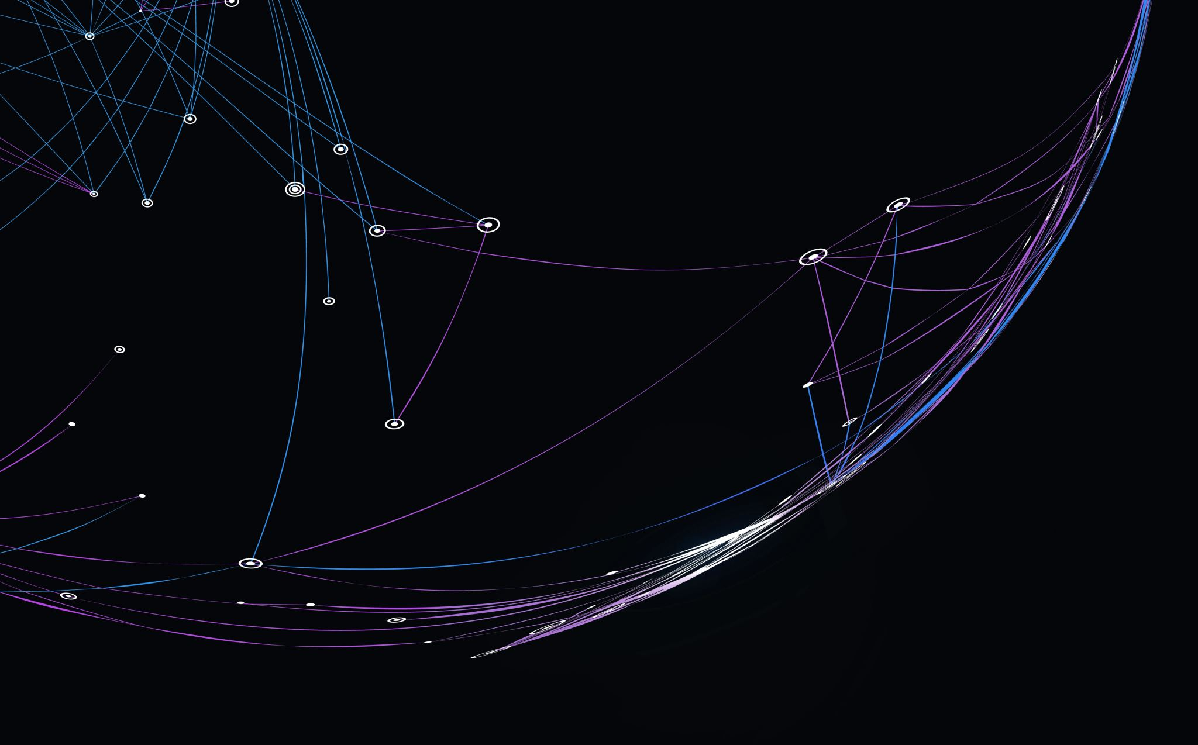
Zequib
Ezekiel Sandor, Jacopo Bulgarelli, Jacopo Gentile, Thomas Colangelo

Slide 2

Research Question and Stakeholder
We are a statistical observatory that was asked by a humanitarian organization to perform some analysis on socio-economical data from different countries, in order to showcase the characteristics of each country. Based on our results they will decide to which countries they’ll bring their help.
To achieve this goal we performed EDA, K-Means and K-Medoids Clustering.

Slide 3
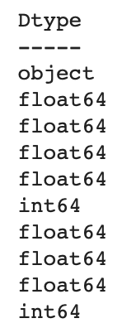
Dataset
Our Dataset is made of the following variables:
country: Name of the country
child_mort: Death of children under 5 years of age per 1000 live births
exports - Exports in % age of the GDP per capita
health - The total spend on health given as % of GDP
imports - The value of imports given as % of GDP per capita
income - The net income per person
inflation - Inflation rate %
life_expec - Average life expectancy in years
total_fer - The fertility rate - Average children per woman in the country
gdpp - GDP per capita

Slide 4
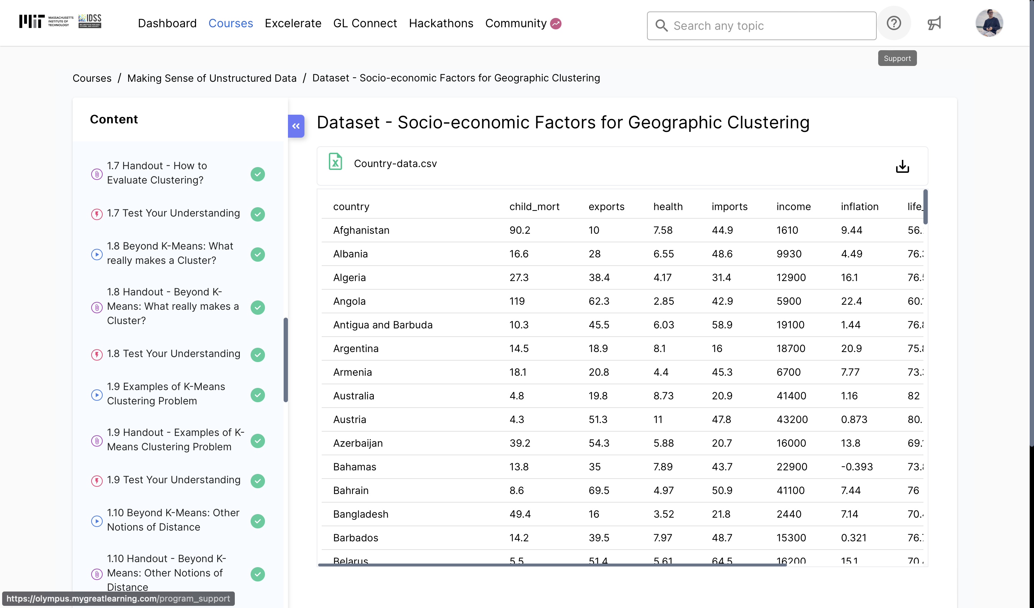
Dataset source

Slide 5
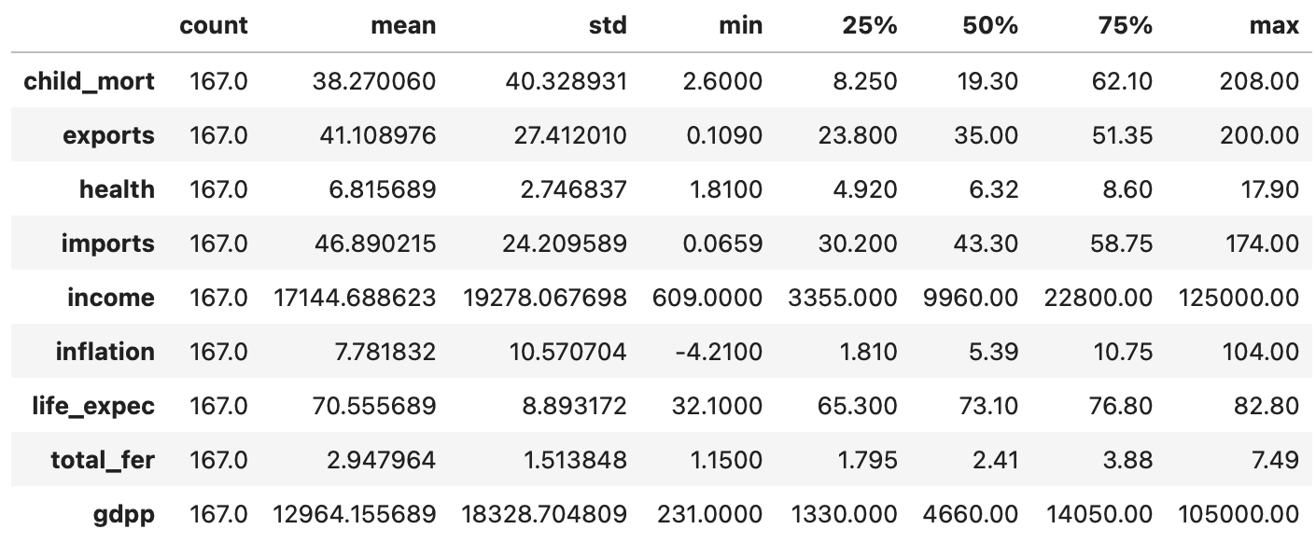
EDA
Here we have the summary statistics of our dataset. We can observe that some variables like child mortality have a big range, from 2.6 to 208 deaths per 1000 live births. In others there’s a big difference between mean and minimum, for example the average life expectancy is around 70 years but the minimum value is just 32 years.

Slide 6
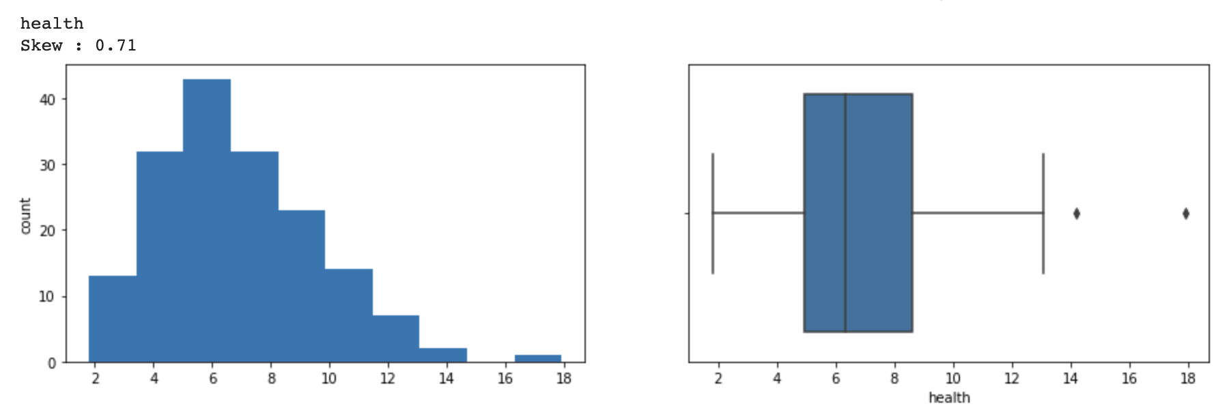
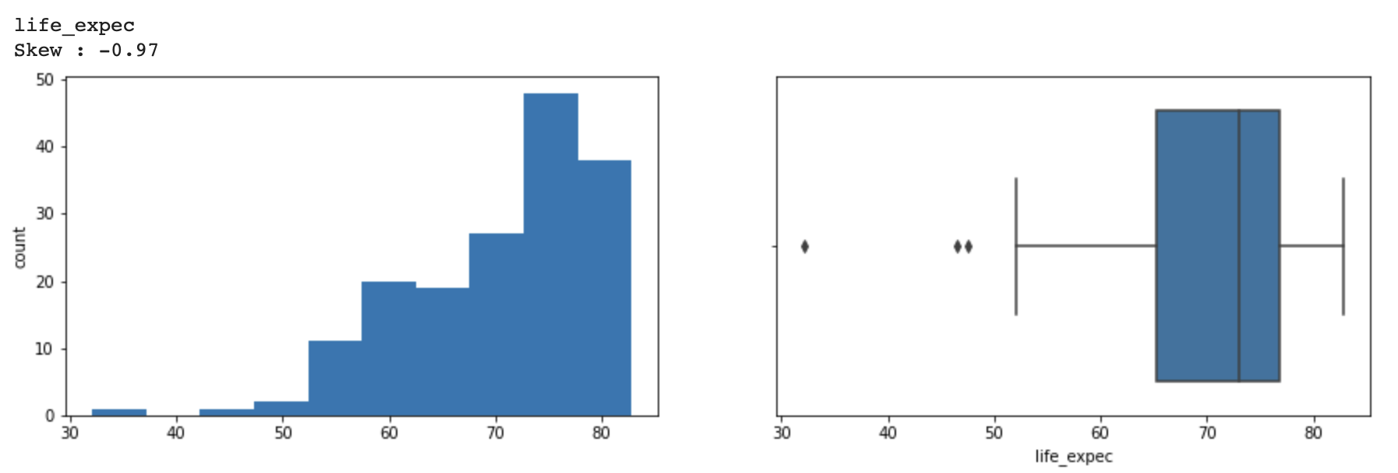
EDA
Overall, the expenditure on health and average life expectancy has lesser standard deviation and just a few outliers, which reflects less variability across countries. All other variables have very high spread across countries.
Health expenditure is the only variable that resembles a gaussian distribution.
The life expectancy is the only variable which is skewed to the left meaning most countries have already been successful in achieving high life expectancy.
These are the variables that might help us identify the clusters, if they exist.

Slide 7
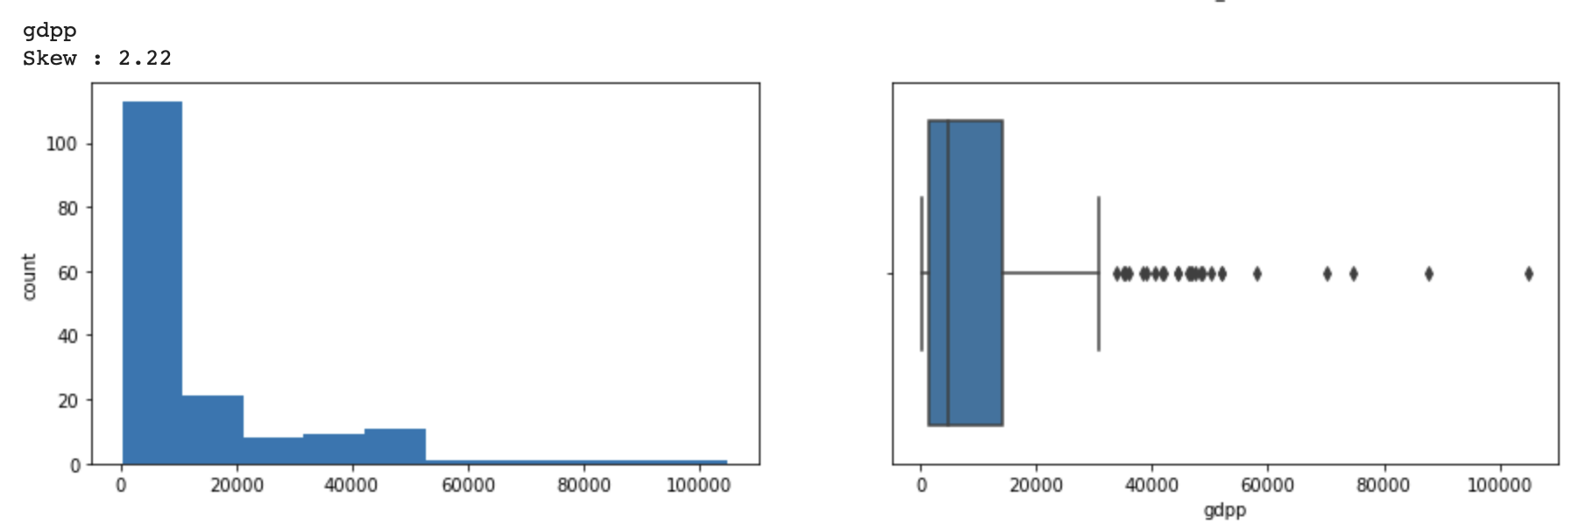
EDA
We can also observe that GDPP is the variable with the most skewed distribution. That comes with a high number of outlier.
We can see how most countries (more than 50%) have a gdpp lower than 10.000$ and the 75% of them is lower than (more or less) 18.000$.

Slide 8
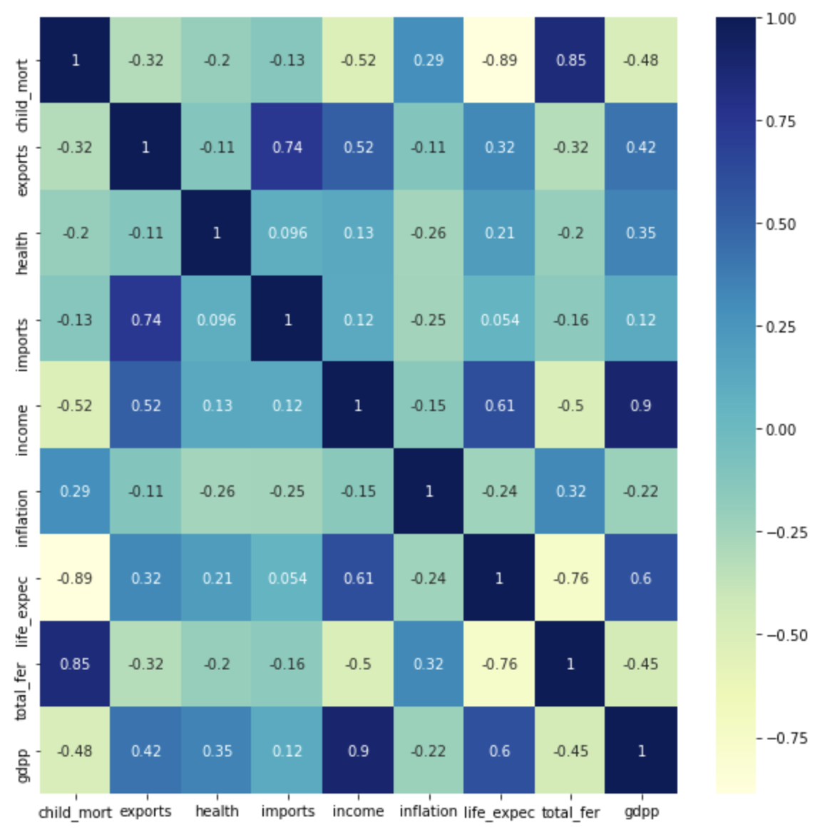
EDA
An important thing to check is the correlation among variables. We can see that:
There is a strong positive correlation between gdpp and income.
The life expectancy is positively correlated with gdpp.
There is a strong negative correlation between life expectancy and child mortality.
The child mortality has a strong positive correlation with fertility rate. This indicates that increasing population leads to higher child mortality.

Slide 9
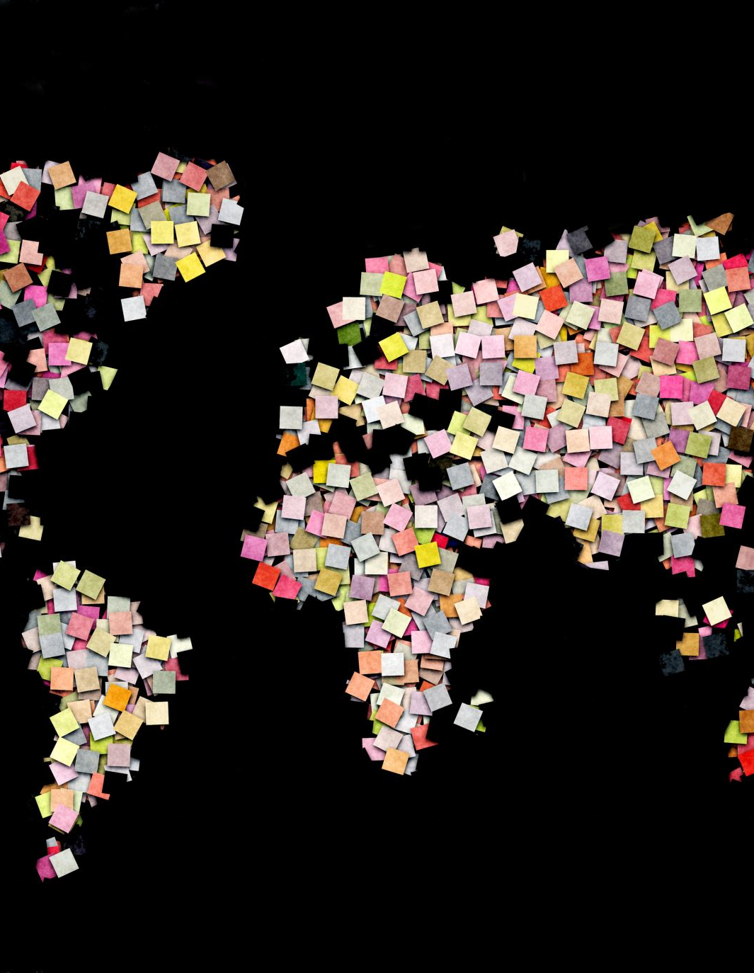
EDA
We then used and slightly modified the function we found at this link:
https://towardsdatascience.com/using-python-to-create-a-world-map-from-a-list-of-country-names-cd7480d03b10
In order to separate the countries by continent, and therfore do an analysis based on that. This could be beneficial for our stakeholder if they want to see which continents are more in need of what.
From what we saw it will be basically useless to consider countries in Europe, North America and South America, as they all have way better stats compared to Oceania but especially Asia and Africa.

Slide 10
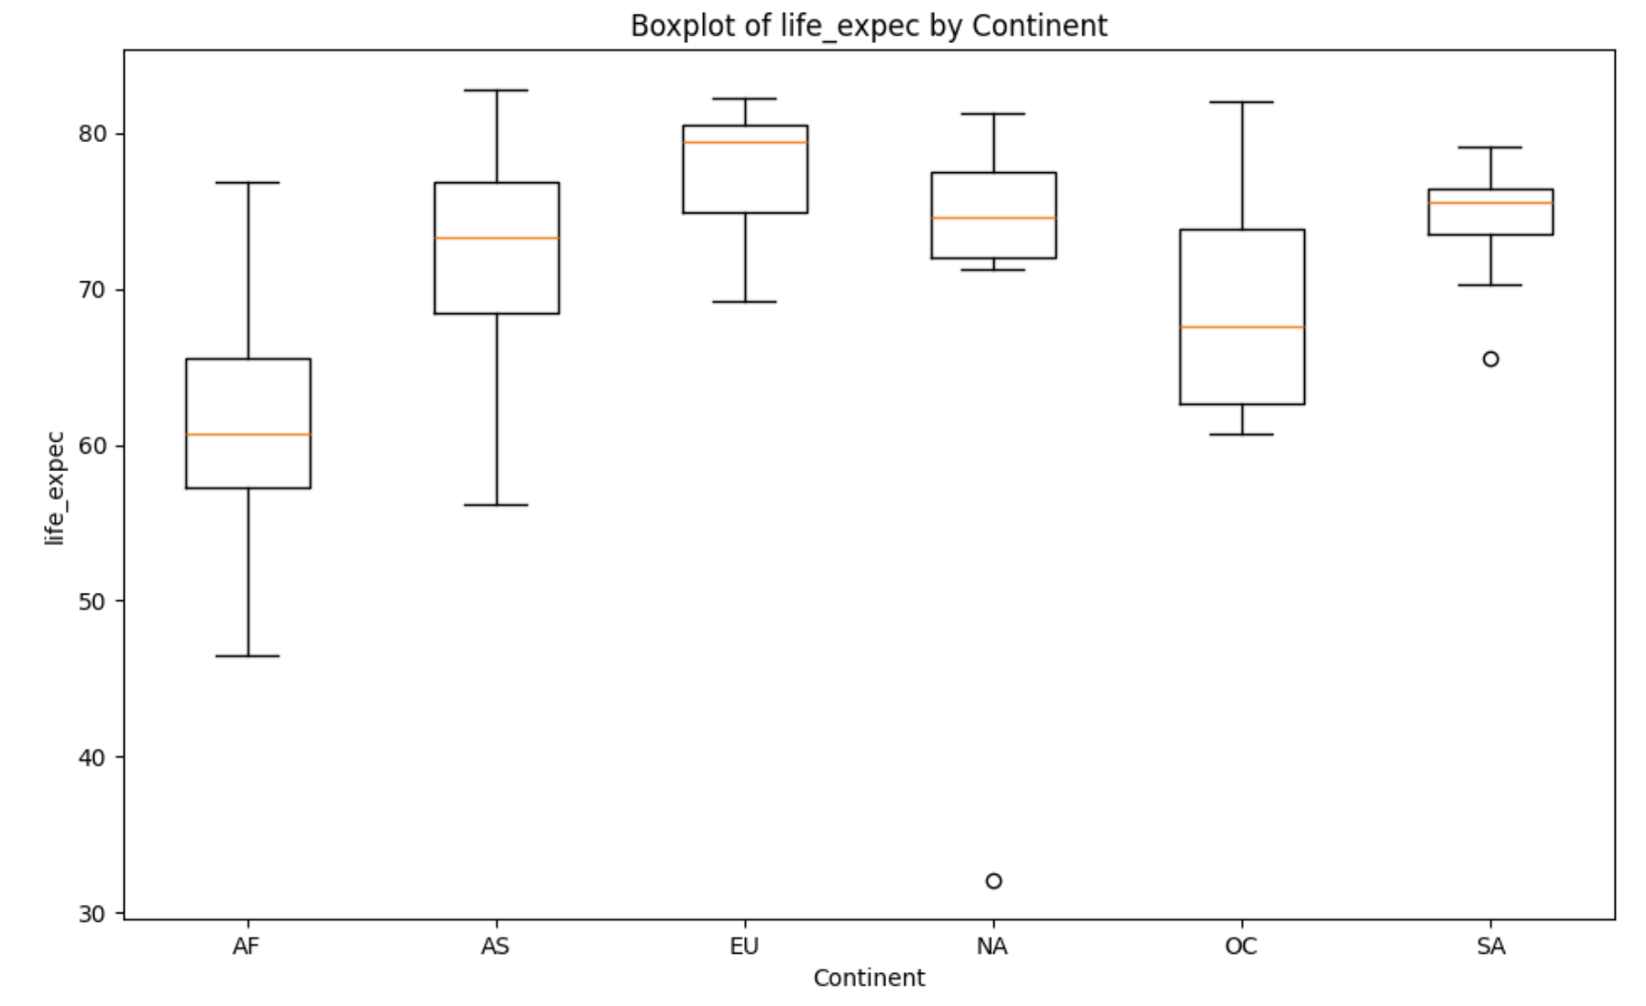
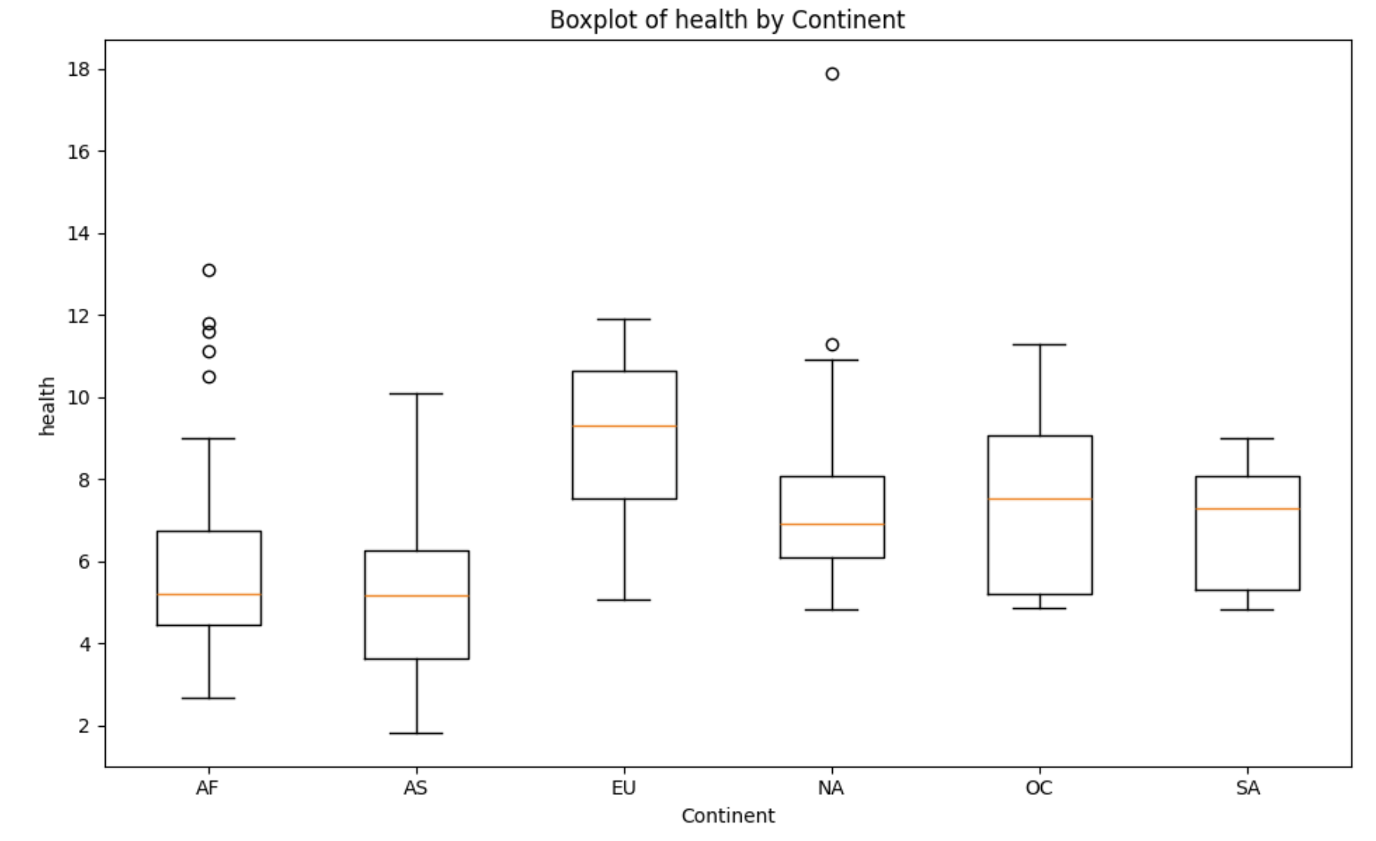
We would suggest to focus their medical aid to african and asian countries, as the health expenditure there is generally lower, in particular Asia has the lowest levels worldwide.
Life expectancy is extremely low in Africa, just a few countries have a life expectancy higher that 70 and in almost half of them is lower than 60. Asia also has some of the worst results (except for Africa) but it also has some of the highest life expectancies worldwide.

Slide 11
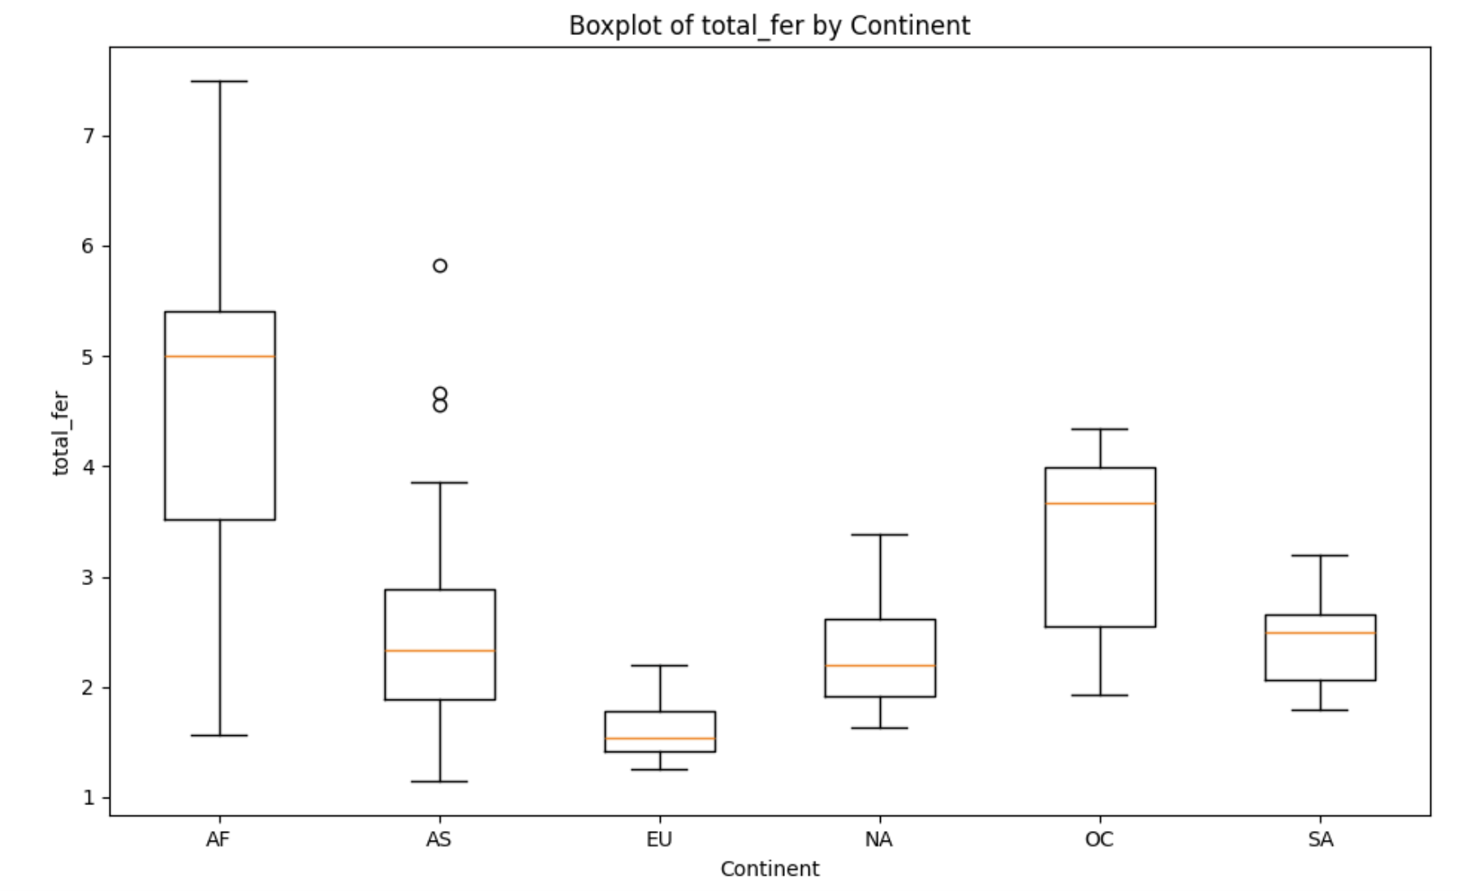
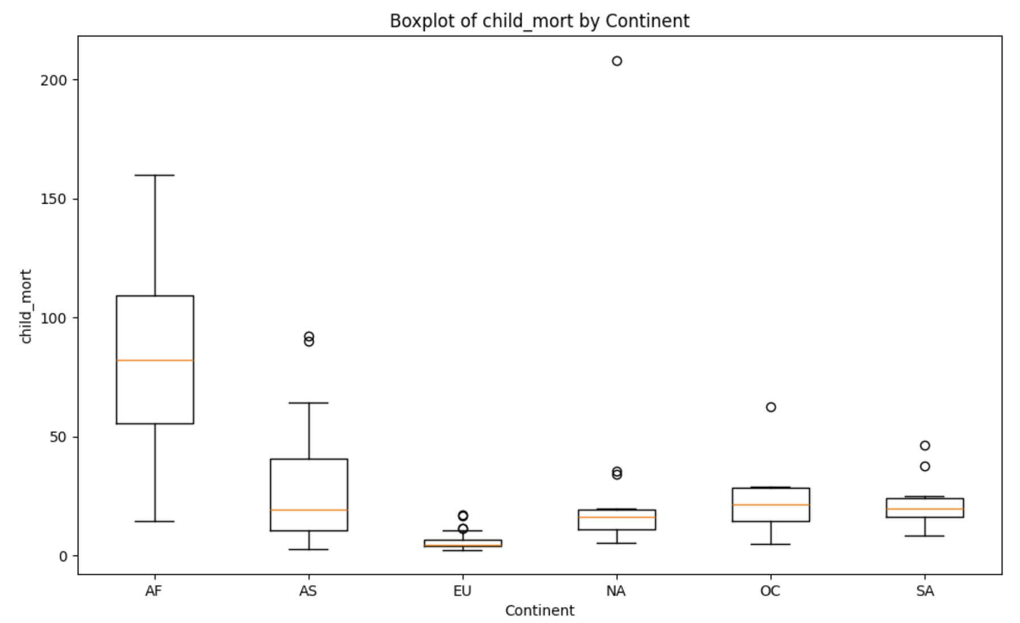
Our stakeholder should send help regarding birth especially to Africa. We can see really high numbers in both child mortality and total fertility. So it would be most appropriate to implement policies to improve the conditions of pregnancy and giving birth, but also to distribute birth control tools.
Asia could benefit a lot from the same policies, although the situation is way better than Africa.

Slide 12
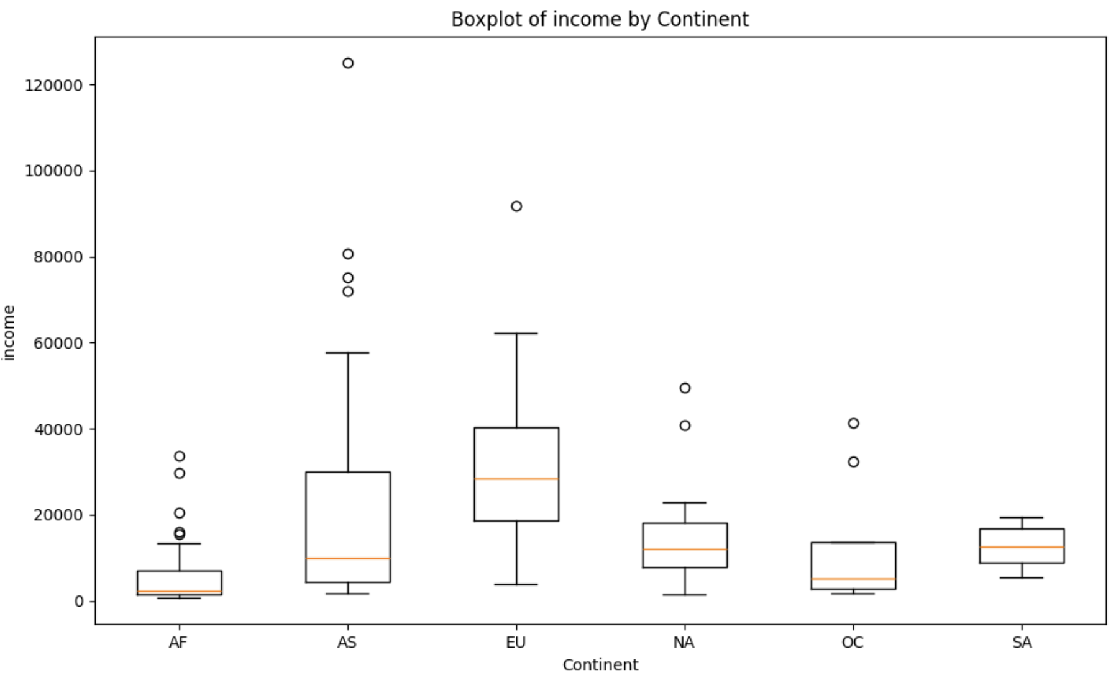
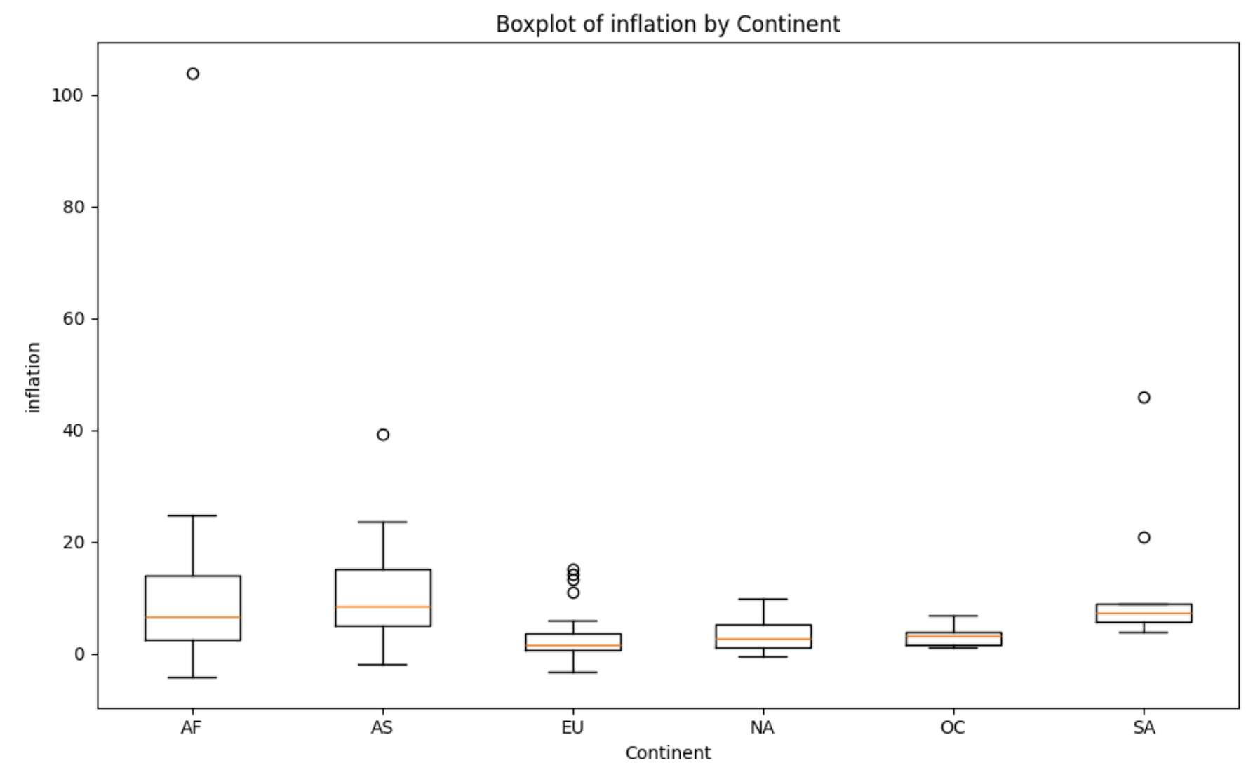
Oceania, South and North America have lower income compared to Asian and European countries, but at least have low inflation.
Asia has really high inflation but salaries aren’t bad.
Africa instead has the lowest incomes and inflation is pretty high, so those salaries are gonna be worth less each year. Our stakeholder could implement policies in Africa to create job opportunities and start programs to teach important skills.

Slide 13
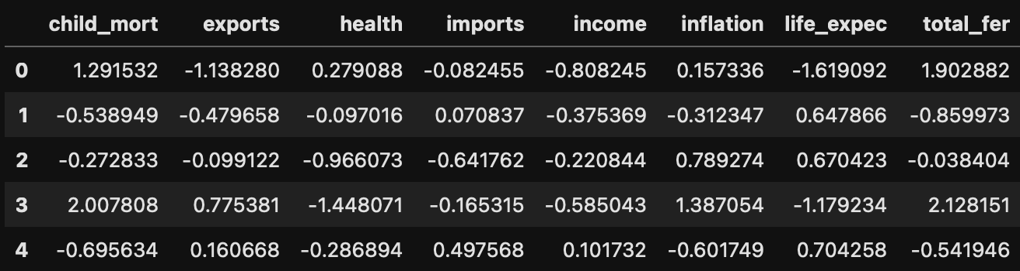
Clustering
We then used some clustering algorithms, which are distance based and are affected by the scale of the variables. Therefore, we scaled the data before applying clustering algorithms, and drop the variables 'country' and 'gdpp' before scaling as we would not use them for clustering the countries.

Slide 14
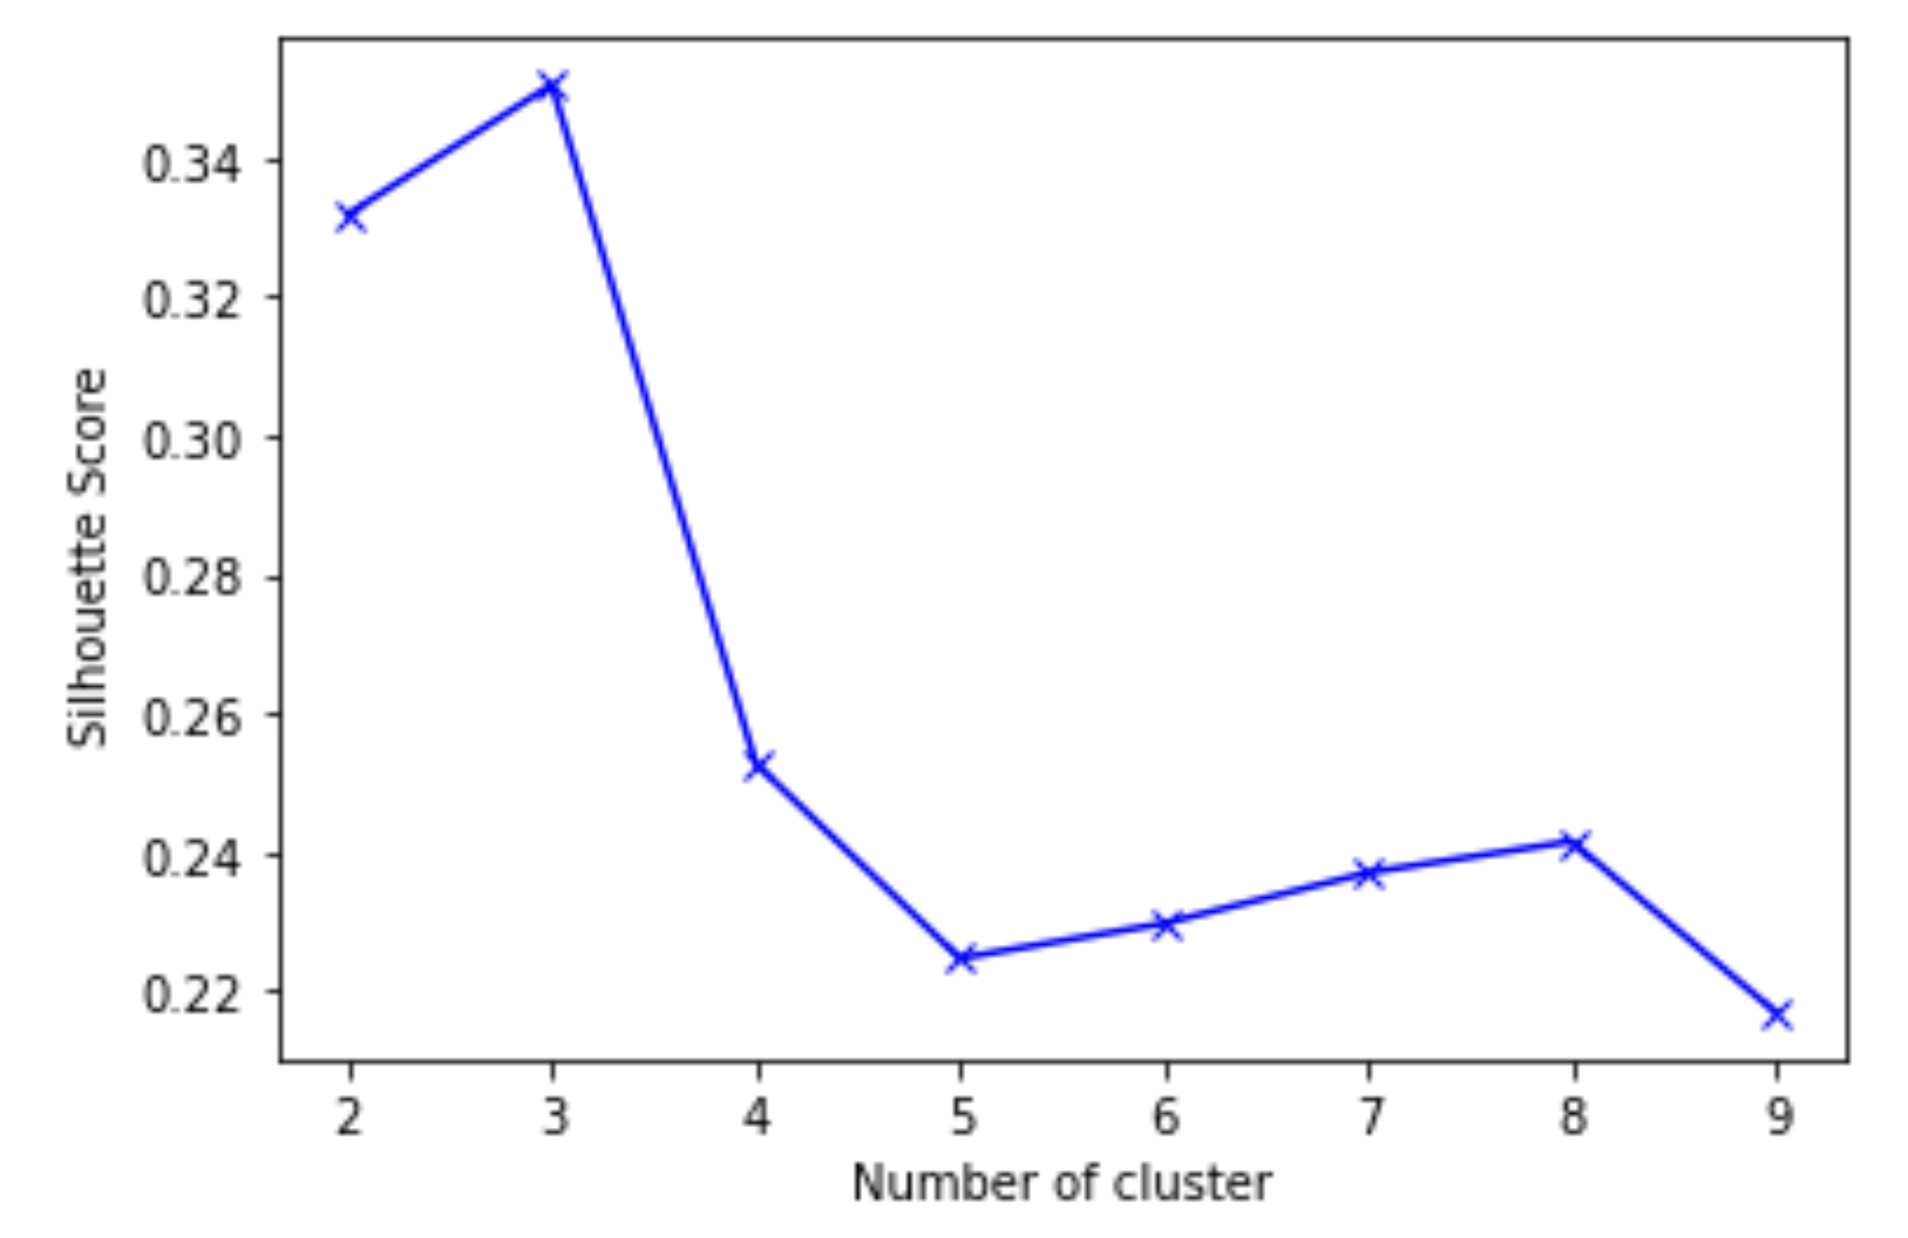
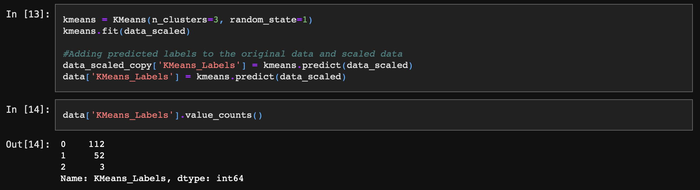
K-means
We can see from the plot that silhouette score is highest for k=3. That makes it slightly easy for us and we can start with first understanding these 3 clusters. So, let's take the number of clusters as 3.
This looks like a very skewed clustering with a very few observations in one cluster and more than 100 in other. So we’ll consider K-Medoids Clustering, that gave us better results.

Slide 15
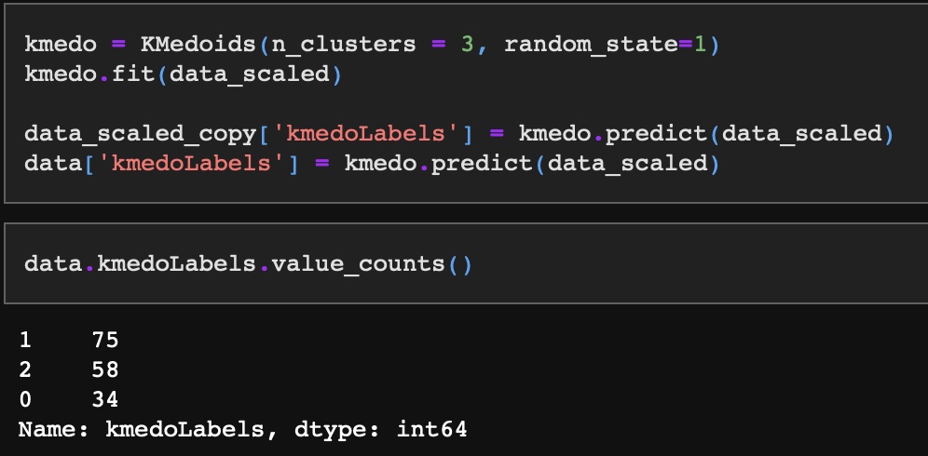
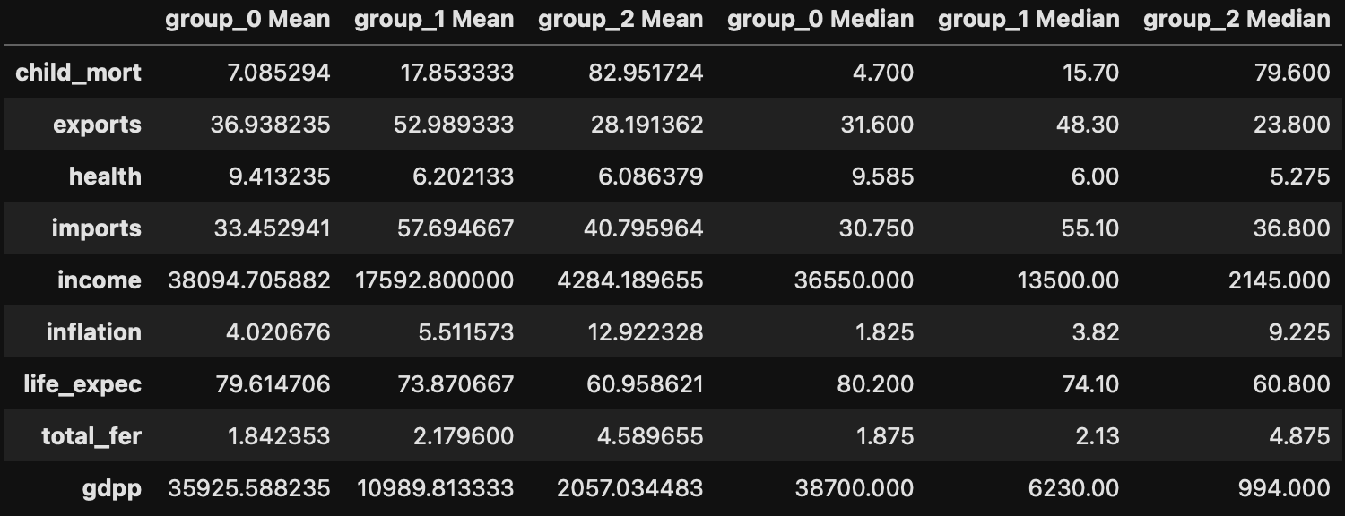
K-Medoids Clustering
It looks like Cluster 0 is of very rich countries, Cluster 2 is of very poor and the rest are in Cluster 1, which happens to be the biggest cluster as well. So intuitively this makes sense but let's try to visualize the boxplots.

Slide 16
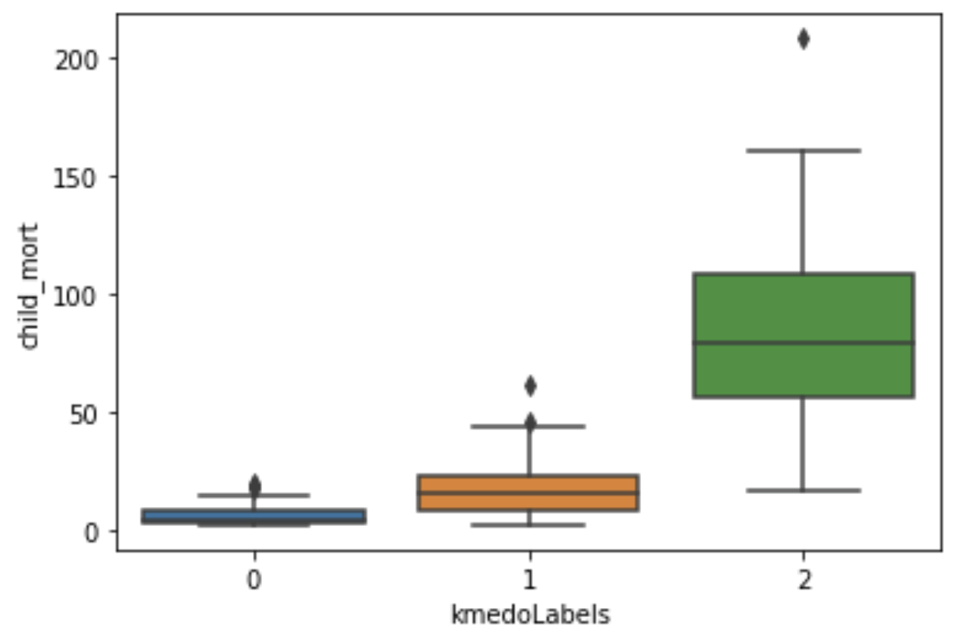
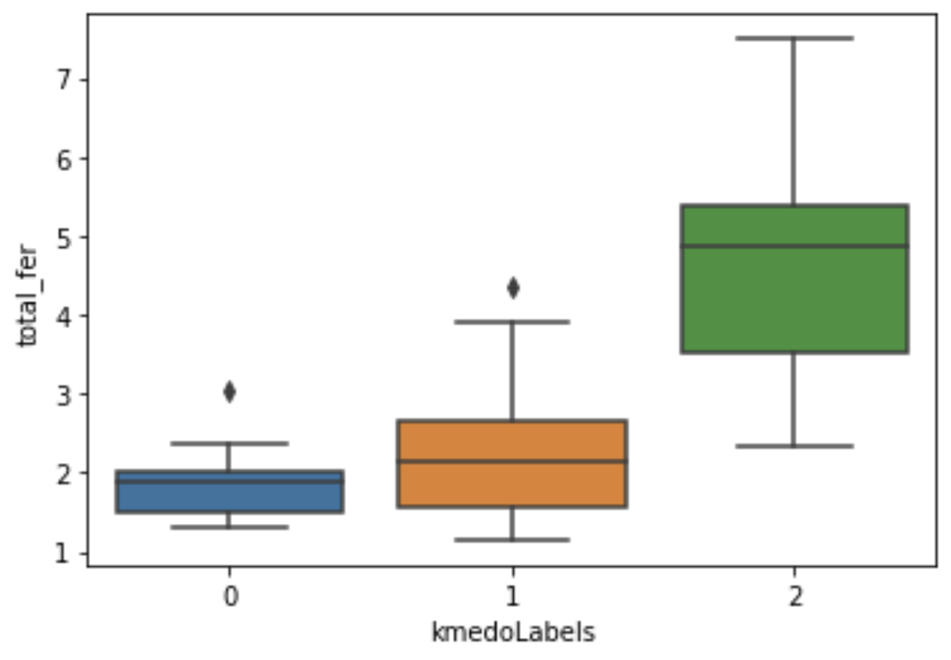
Cluster 2 countries have the highest average child mortality rate, trade deficit, inflation rate and least average GDP and net income per person. But the large range of values for different variables implies it contains variety of countries from underdeveloped to developing. For example, Afghanistan, Bangladesh, Botswana.

Slide 17
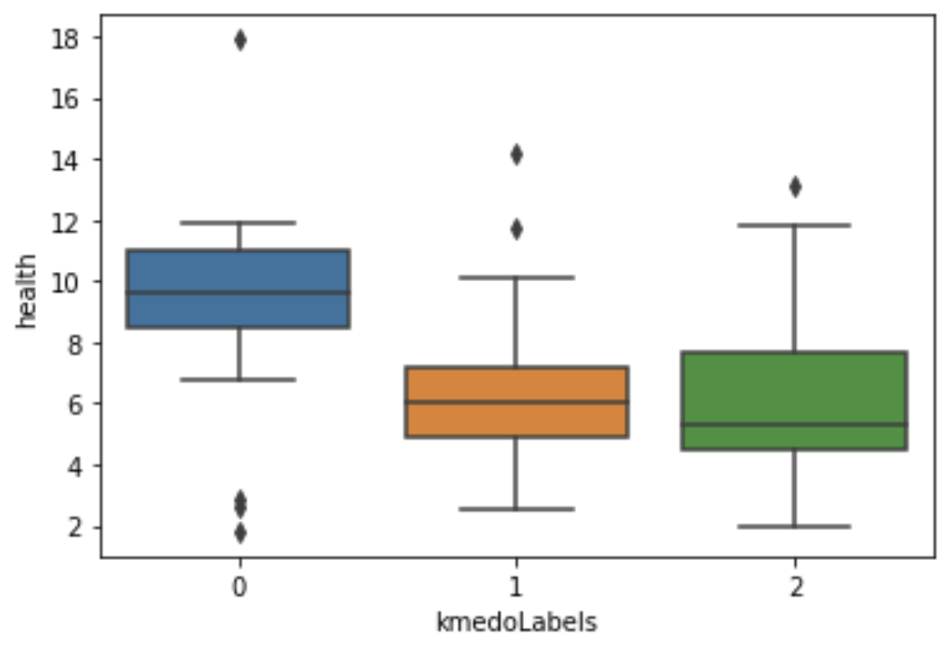
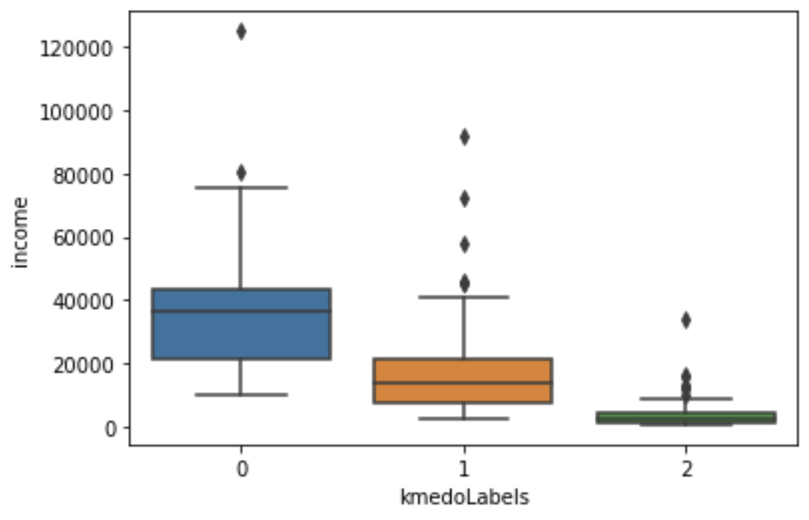
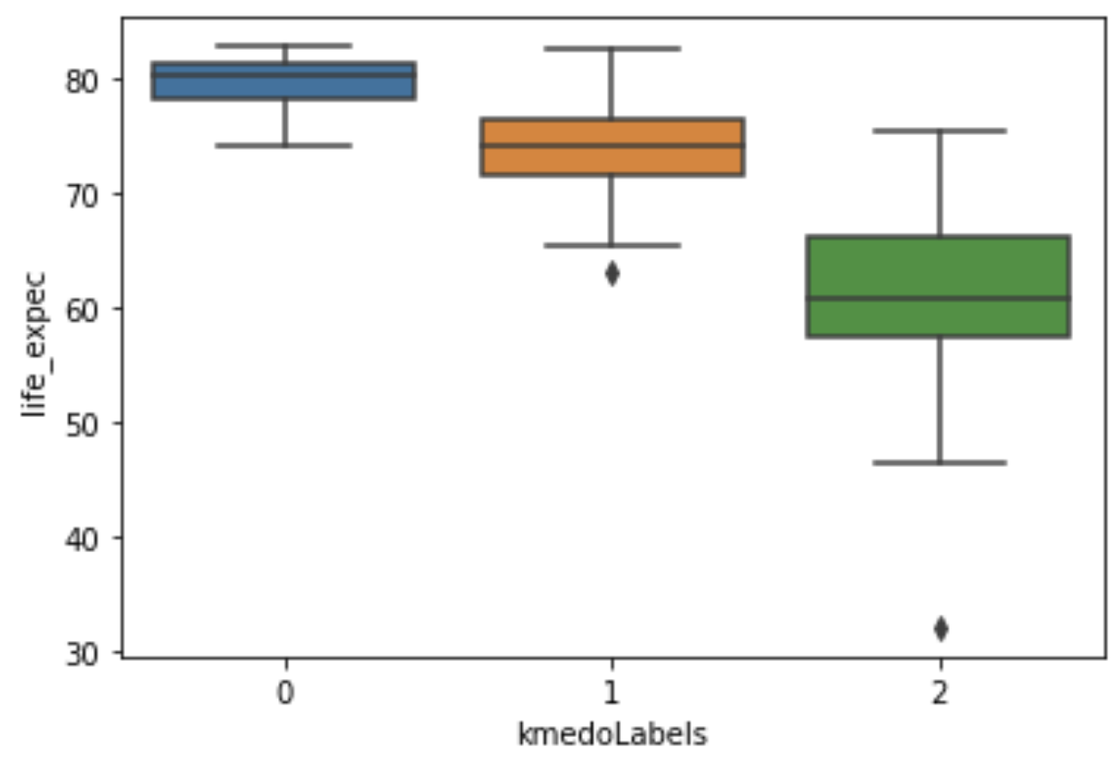

Slide 18

Additional material
We will now see some more graphs that we made using different algorithms, that helped us analyzing better this dataset, and get better insights

Slide 19
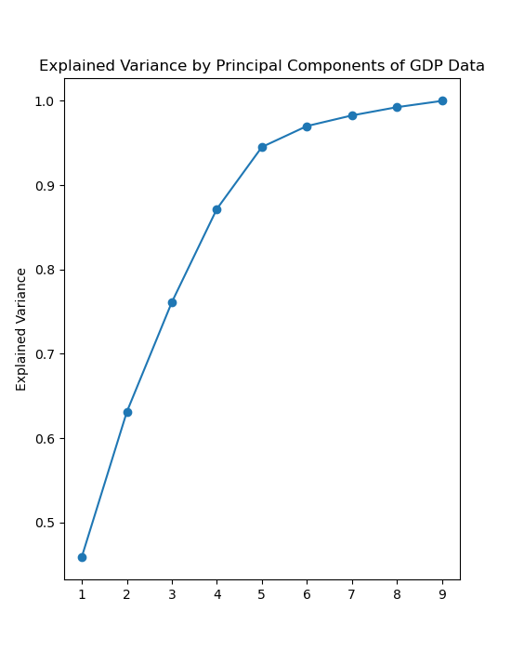
First of all, we found an elbow in terms of explained variance of around 5 dimensions.
This means that the first 4/5 dimensions in our data capture a significant portion of the total variance.

Slide 20
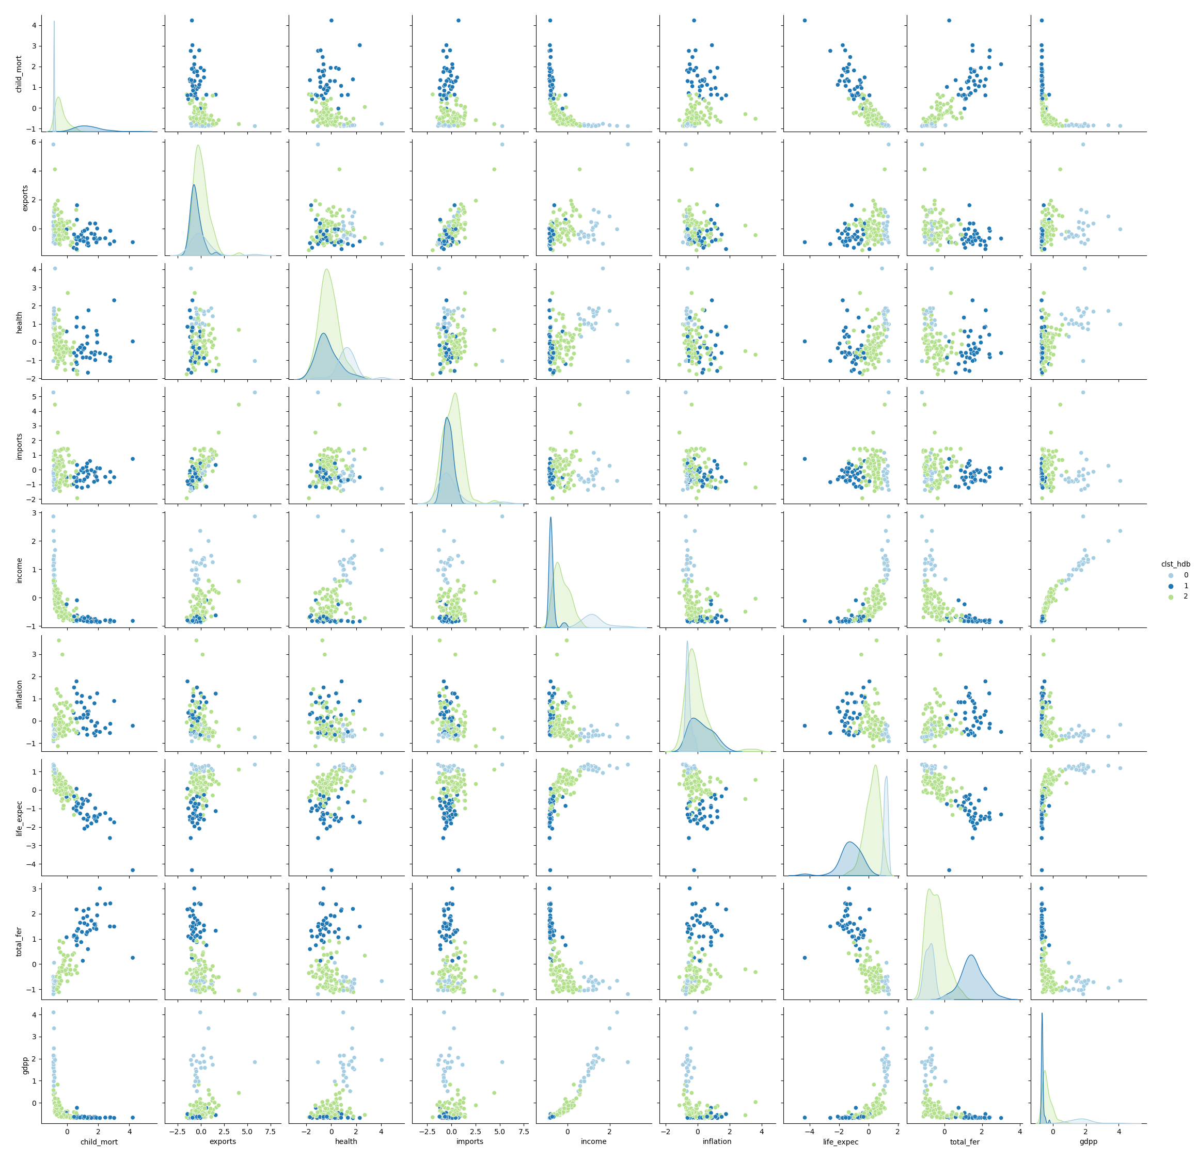

Slide 21
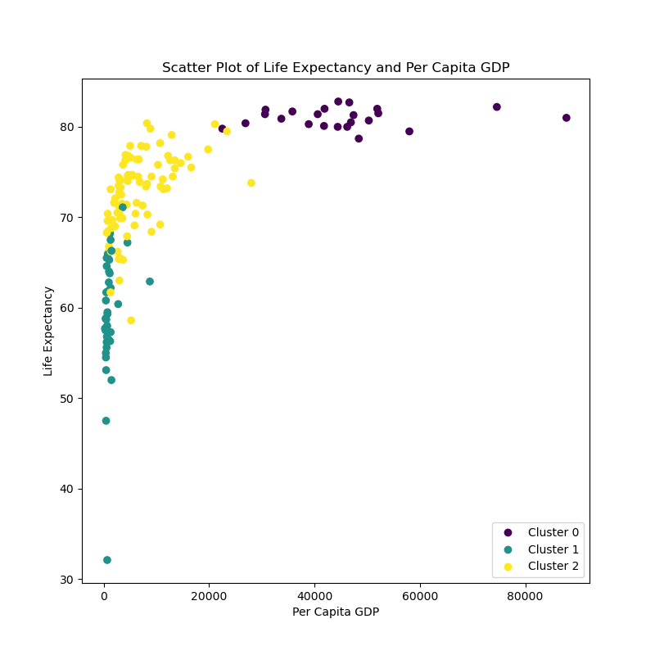
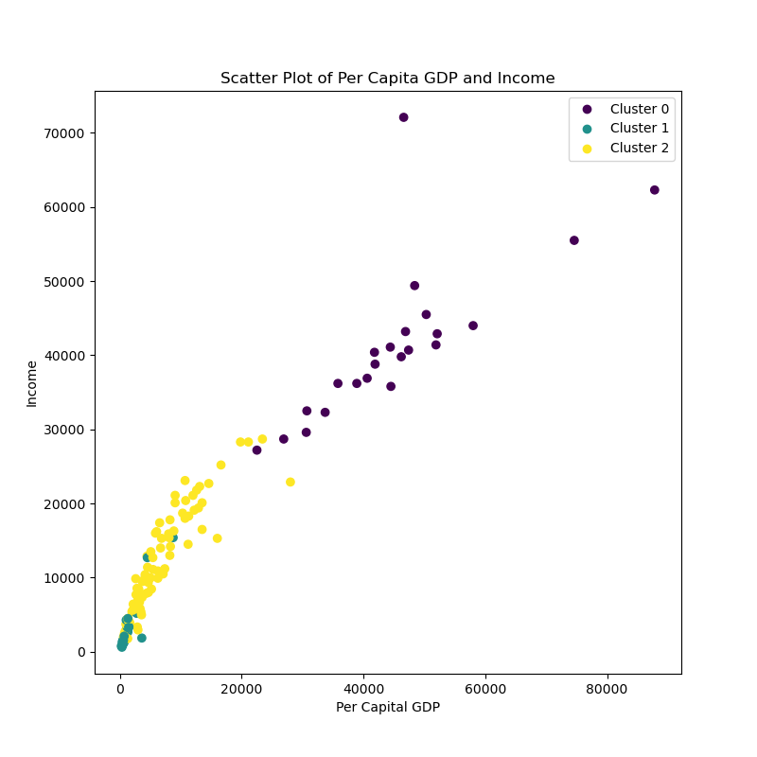
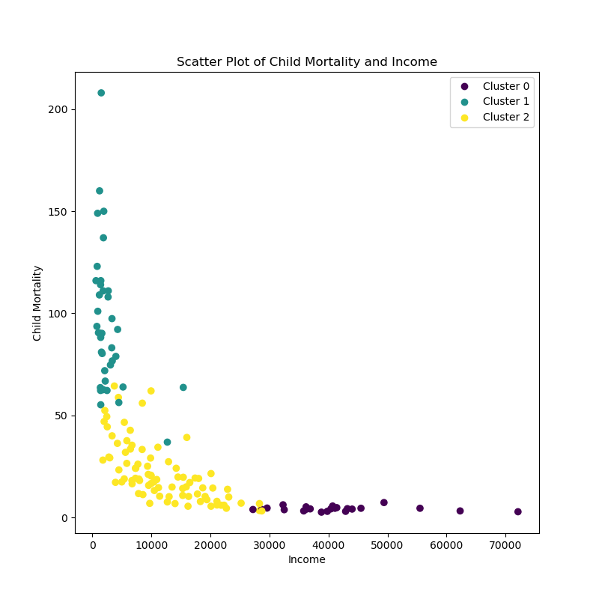
The previous graph is not interpretable being that big, so we selected three graphs from it that give us good insights. As we can see from these three graphs, our clustering clearly breaks down into what we would generally call undeveloped, developing, and developed economies.

Slide 22
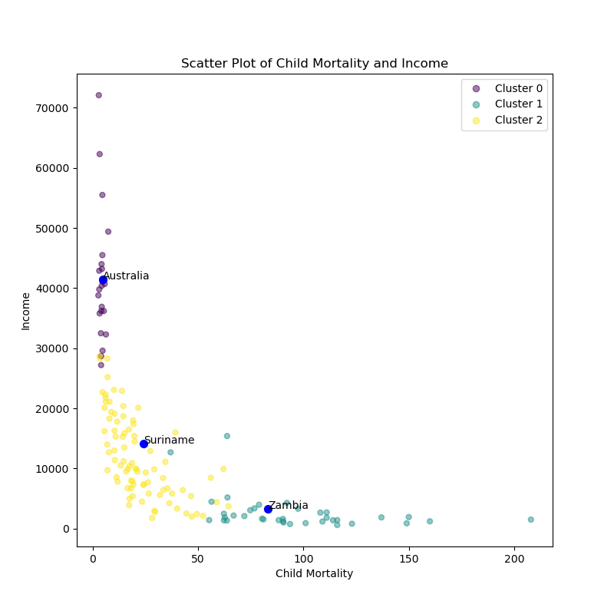
Here we decided to look for the most representative sample from each cluster in order to have a general idea of the countries we are studying.

Slide 23
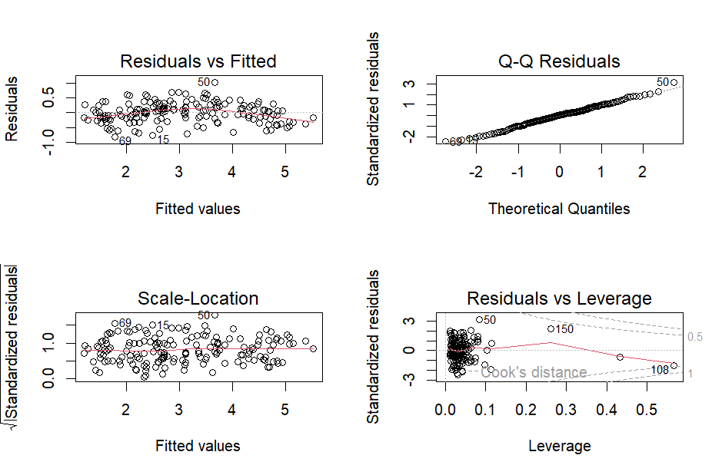
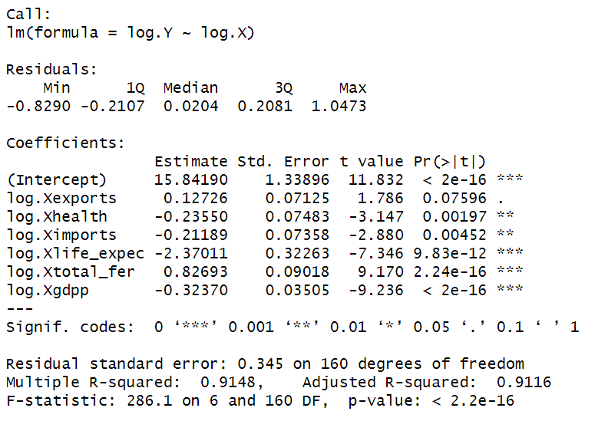
Our stakeholder is obviously very interested in reducing child mortality. We had to take the log of both dependent and independent variables, limiting explainability.

Slide 24
Thank you!

